Slide 1
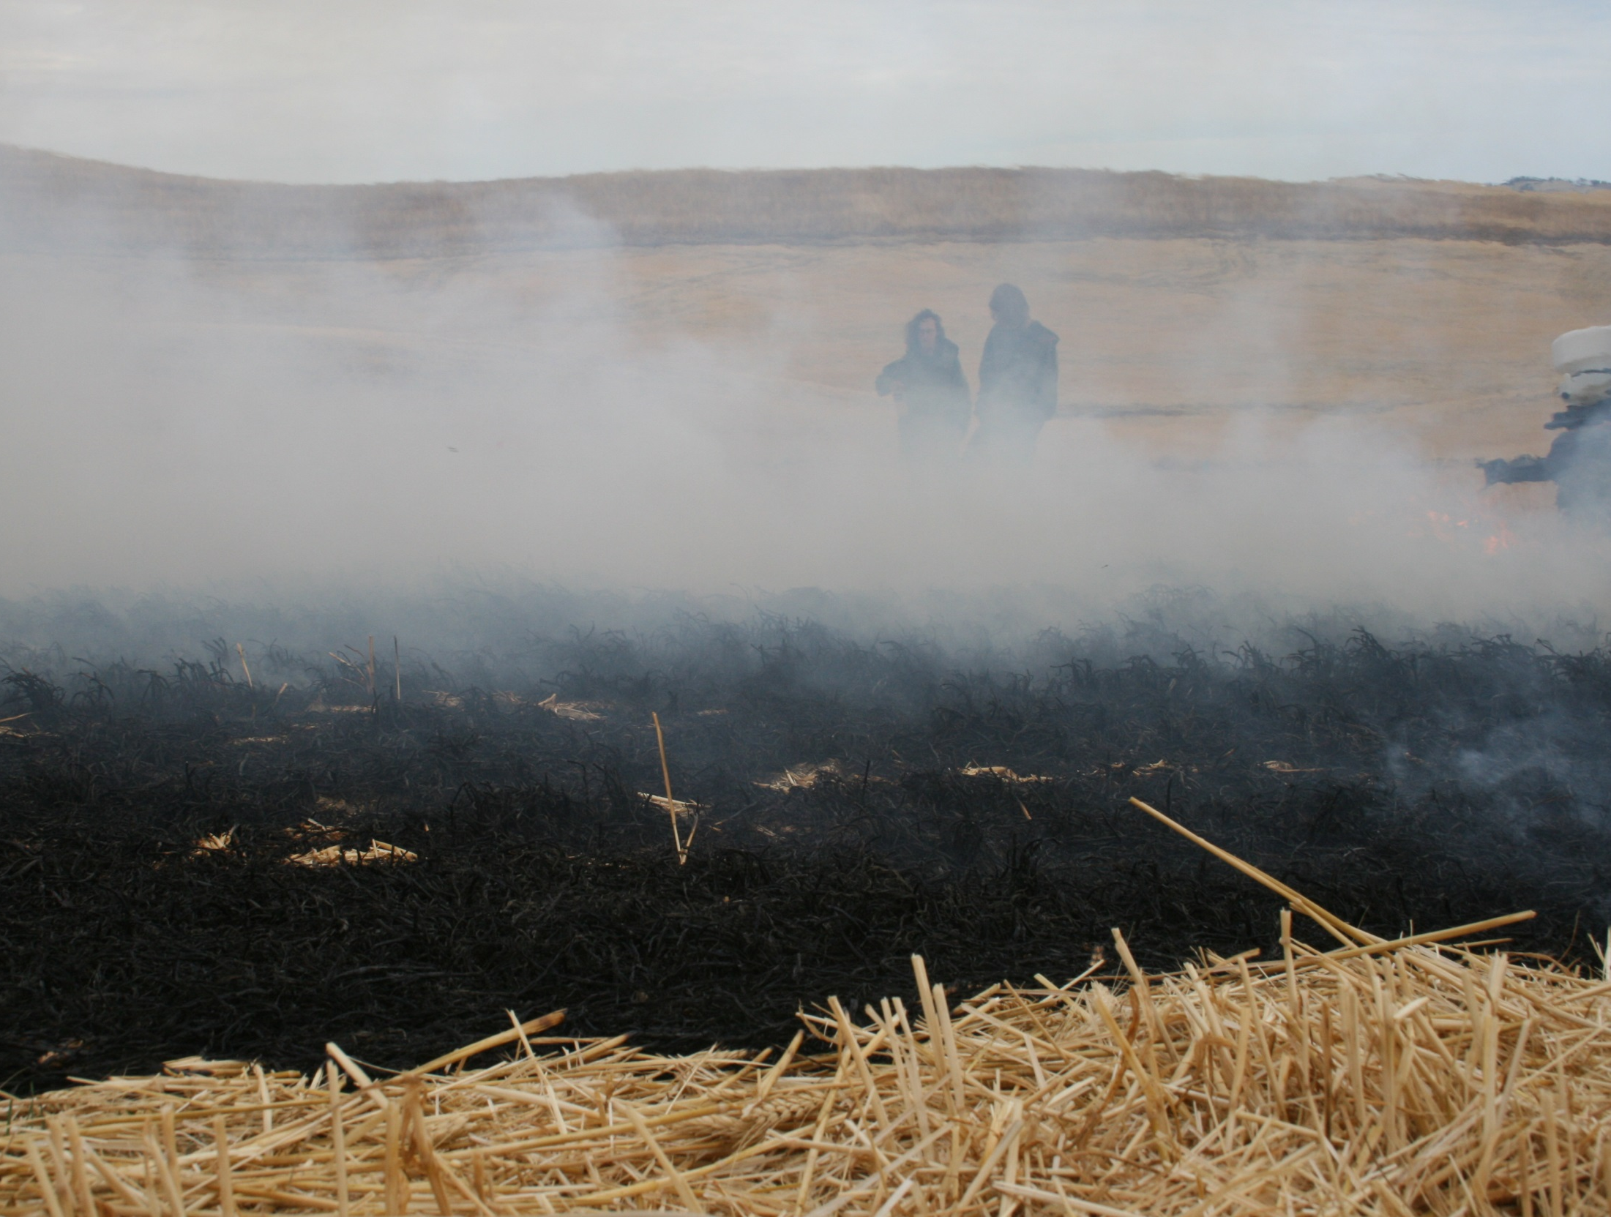
Alternatives for Managing Wheat Straw
Assessing Soil Water Storage,
Nutrient Status and Removal, and
Weed Management
Dave Huggins, USDA-ARS
Drew Lyon, WSU Weed Science
Wayne Thompson, Agronomist/Soil Scientist

Slide 2
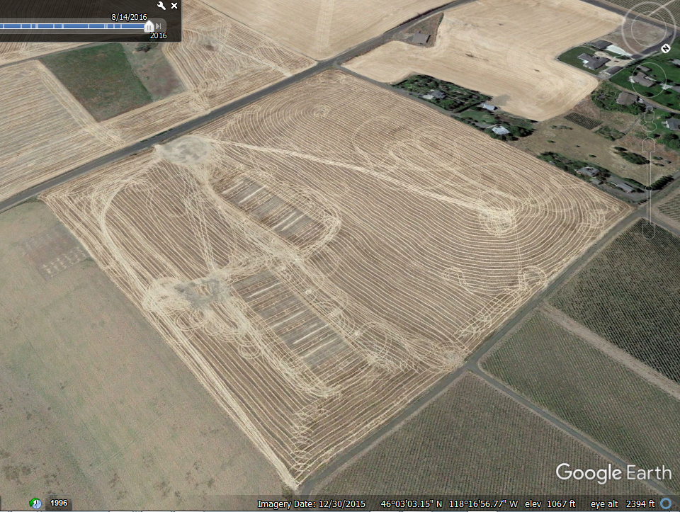
Aerial Image of SITES One and Two
Cooperators: West aspect and East aspect
Dave and Dwelley Jones, Walla Walla County Producers
SITE Three: Cook Agronomy Farm, Pullman

Slide 3
Residue Management Effects on Daily Temperatures: Summary of soil and canopy temperature from heading through senescence, soft white wheat
Temperature Data Logging Stations
  Three depths in soil: 15 cm, 30 cm, and 45 cm
  One position inside crop canopy: 30 cm
  One positioned above canopy: 1 m
A blanket of residue on soil surface serves as insulation, isolating soil temperatures from canopy temperatures
  Soil temperatures remain consistently cooler with minor diurnal variation
  The magnitude of diurnal variation in canopy temperature is very similar to temperature variations above the crop canopy
Under no soil cover, diurnal variation in soil and canopy temperatures show parallel diurnal temperature patterns
  High to low soil temperatures follow high to low canopy temperatures
  The magnitude of diurnal variation of canopy and soil temperature is lower than the magnitude of diurnal variation above the crop canopy
The control, positioned in a no-till system with no crop canopy had the largest magnitude in near-surface (30-cm) diurnal temperature variation, with consistently higher soil temperatures

Slide 4
Temperature logging station
Crop canopy/near-surface and soil temperatures at three depths.
(a) rigid 5-cm × 75-cm white PVC tube capped with a 90° PVC elbow;
(b) Labjack Digit-TL temperature data logger sealed in red aluminum capsule and dangled with wire inside of PVC tube;
(c) sixteen 1.9-cm holes to facilitate free/convective air-flow through PVC tube;
(d, e, f) Lascar EL-USB-1 temperature data loggers in brushed aluminum capsules buried vertically at resting depths of 15 cm (d), 30 cm (e), and 45 cm (f).
a
b
55 cm
c
SOIL SURFACE
d
45 cm
e
f

Slide 5
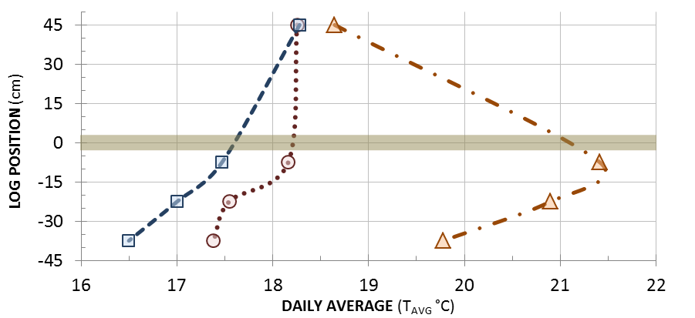
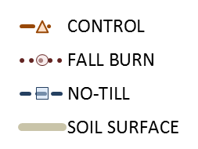
Crop residue layer serves as insulation
Warmest soil, highest near-surface air temperature.
No soil cover, warm soil temperatures under crop canopy.
Coolest soil under thick cover.

Slide 6
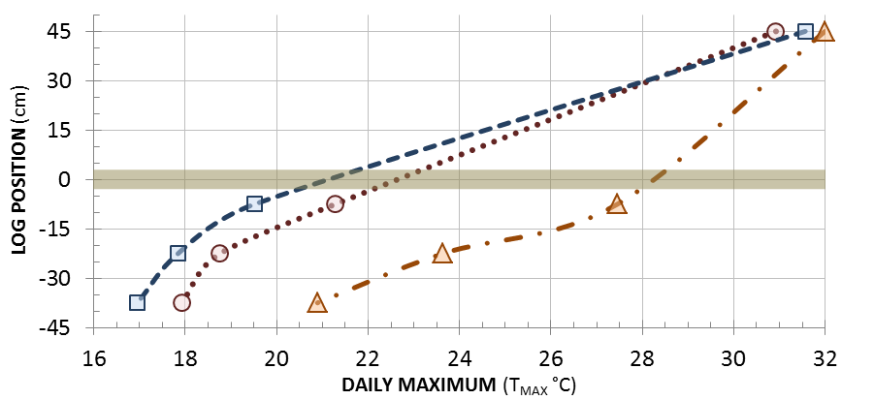
Crop residue layer serves as insulation
Exposed to direct sunlight, warmest soil (P<0.0001).
No soil cover, cooler soil buffers canopy temperature.
Coolest soil under thick cover, isolates canopy T from soil T.

Slide 7
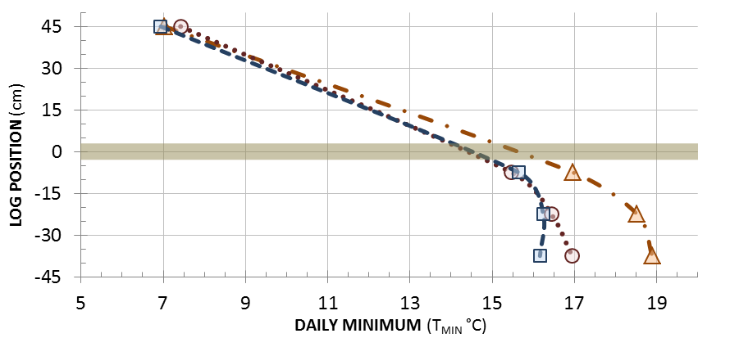
Crop residue layer serves as insulation
Warmest soil, cool near-surface air temperature (P<0.0001).
No soil cover, soil temperature buffers canopy ΔT.
Coolest soil under thick cover, isolates canopy ΔT from soil ΔT.

Slide 8
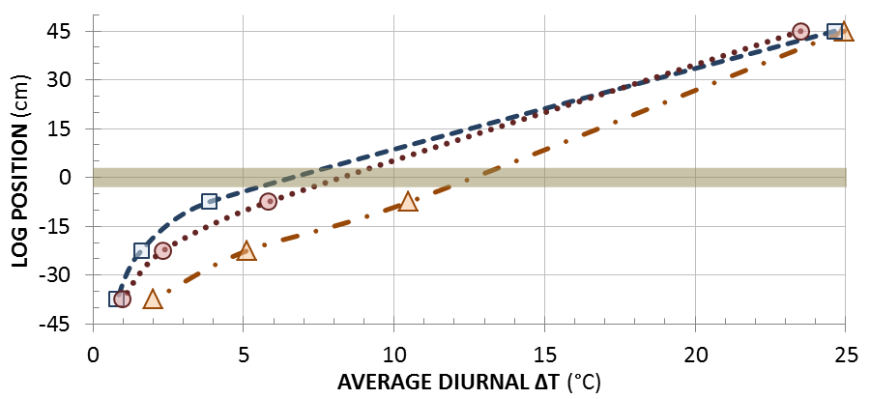
Crop residue layer serves as insulation
Largest ΔT, both soil and near-surface air temperatures
Smallest canopy ΔT, higher soil ΔT over no-till
Canopy ΔT same as control, soil ΔT’s lower than fall-burn and control

Slide 9
LOG |  | FALL-BURN |  |  |  |  | NO-TILL |  |  |  |  | CONTROL |  |  |  |  | P-Values by SOURCE
POSITION |  | WEST |  | EAST |  |  | WEST |  | EAST |  |  | WEST |  | EAST |  |  | ASPCTxTRT | ASPECT | TRT
-------------------------------------------------------- Daily Average Temperature (°C) --------------------------------------------------------
CANOPY |  | 19.0 | b | 18.7 | b |  | 19.6 | a | 18.5 | b |  | 19.6 | a | 19.1 | ab |  | 0.1688 | 0.0002 | 0.0610
5-15 cm |  | 19.2 | c | 19.0 | d |  | 18.6 | d | 18.1 | e |  | 22.6 | a | 22.3 | b |  | 0.8541 | 0.0000 | 0.0000
20-30 cm |  | 18.4 | c | 18.6 | d |  | 18.0 | e | 17.8 | e |  | 22.6 | a | 21.5 | b |  | 0.0000 | 0.0000 | 0.0000
35-45 cm |  | 18.6 | c | 18.4 | d |  | 17.3 | e | 17.3 | f |  | 21.3 | a | 20.6 | b |  | 0.0415 | 0.0000 | 0.0000
-------------------------------------------------------- Daily Maximum Temperature (°C) --------------------------------------------------------
CANOPY |  | 32.3 | b | 31.3 | c |  | 33.5 | a | 31.8 | bc |  | 34.1 | a | 32.0 | bc |  | 0.2575 | 0.0000 | 0.0006
5-15 cm |  | 22.6 | b | 22.9 | b |  | 21.1 | c | 20.5 | d |  | 29.2 | a | 29.8 | a |  | 0.0314 | 0.1015 | 0.0000
20-30 cm |  | 19.8 | c | 20.2 | c |  | 18.9 | d | 18.7 | d |  | 25.7 | a | 24.1 | b |  | 0.0000 | 0.0000 | 0.0000
35-45 cm |  | 19.3 | c | 19.0 | d |  | 17.8 | e | 17.8 | f |  | 22.6 | a | 21.9 | b |  | 0.0161 | 0.0000 | 0.0000
-------------------------------------------------------- Daily Minimum Temperature (°C) --------------------------------------------------------
CANOPY |  | 8.8 | a | 8.0 | bc |  | 8.7 | a | 7.2 | d |  | 8.4 | ab | 7.7 | cd |  | 0.0888 | 0.0000 | 0.1587
5-15 cm |  | 16.3 | c | 15.9 | d |  | 16.6 | bc | 16.0 | d |  | 18.0 | a | 17.0 | b |  | 0.0001 | 0.0000 | 0.0000
20-30 cm |  | 17.3 | c | 17.1 | de |  | 17.3 | d | 16.9 | e |  | 20.0 | a | 19.1 | b |  | 0.0374 | 0.0000 | 0.0000
35-45 cm |  | 18.2 | c | 17.8 | d |  | 17.0 | e | 16.9 | f |  | 20.3 | a | 19.7 | b |  | 0.2935 | 0.0000 | 0.0000

